Slide 1
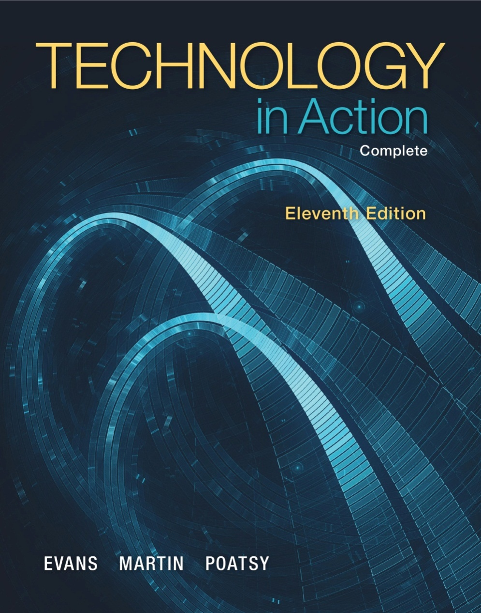
Technology in Action
Alan Evans • Kendall Martin
Mary Anne Poatsy
Eleventh Edition
Notes:
Welcome to Chapter 2: Looking at Computers: Understanding the Parts

Slide 2
Technology in Action
Chapter 2
Looking at Computers: Understanding the Parts
Notes:
In Chapter 2, we discuss what a computer does and how its functions make it such a useful machine.

Slide 3
Chapter Topics
Understanding Your Computer
Input Devices and Output Devices
Processing, Memory, and Storage
Ports and Power Controls
Setting It All Up
Notes:
3
Chapter topics include:
Understanding your computer
Input devices and output devices
Processing, memory, and storage
Ports and power controls
Setting it all up

Slide 4
Understanding Your Computer: Computers are Data Processing Devices
Perform four major functions
Input: Gather data, enter data
Process: Manipulates, calculates, or organizes data
Output: Displays data and information
Storage: Saves data and information
Notes:
4
Strictly defined, a computer is a data processing device that performs four major functions:
1. Input: It gathers data, or allows users to enter data.
2. Process: It manipulates, calculates, or organizes that data into information.
3. Output: It displays data and information in a form suitable for the user.
4. Storage: It saves data and information for later use.

Slide 5
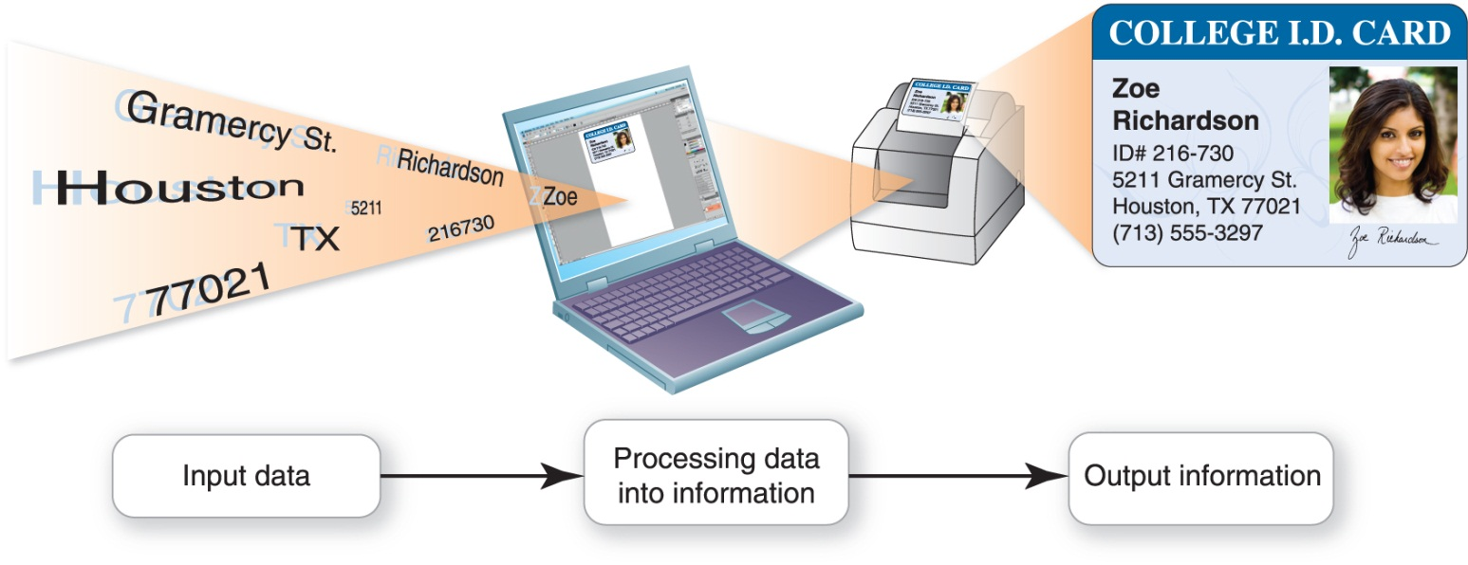
Understanding Your Computer: Computers are Data Processing Devices (cont.)
Data
Information
Processing
Notes:
5
Data is a representation of a fact, figure, or idea. Data can be a number, a word, a picture, or even a recording of sound. For example, the number 7135553297 and the names Zoe and Richardson are pieces of data.
Information is data that has been organized or presented in a meaningful fashion. When your computer provides you with a contact listing that indicates Zoe Richardson can be reached by phone at (713) 555-3297, the data becomes useful information.
Processing is manipulating, calculating, or organizing data into information.

Slide 6
Understanding Your Computer: Bits and Bytes: The Language of Computers
Bit
Binary digit
0 or 1
Byte
8 bits
Unique combinations of 8 bits of 0s and 1s
Notes:
6
To process data into information, computers need a language they understand. This language, called binary language, consists of just two digits: 0 and 1.
Everything a computer does, such as processing data, printing a report, or editing a photo, is broken down into a series of 0s and 1s.
Each 0 and 1 is a binary digit, or bit for short. Eight binary digits (or bits) combine to create 1 byte.
In computers, each letter, number, and special character (such as the @ sign) consists of a unique combination of 8 bits, or a string of eight 0s and 1s.

Slide 7
Understanding Your Computer: Bits and Bytes: The Language of Computers (cont.)
Name | Abbreviation | Number of Bytes
Byte | B | 1 byte
Kilobyte | KB | 1,024 bytes (2¹⁰)
Megabyte | MB | 1,048,576 bytes (2²⁰ bytes)
Gigabyte | GB | 1,073,741,824 bytes (2³⁰ bytes)
Terabyte | TB | 1,099,511,627,776 bytes (2⁴⁰ bytes)
Petabyte | PB | 1,125,899,906,842,62 bytes (2⁵⁰ bytes)
Exabyte | EB | 1,152,921,504,606,846,976 bytes (2⁶⁰ bytes)
Zettabyte | ZB | 1,180,591,620,717,411,303,424 bytes (2⁷⁰ bytes)
Notes:
Files and applications can be quite large, containing thousands or millions of bytes.
To make it easier to measure the size of files, we need units of measure larger than a byte. Kilobytes, megabytes, and gigabytes are therefore simply larger bytes. As shown in the table, a kilobyte (KB) is approximately 1,000 bytes, a megabyte (MB) is about 1 million bytes, and a gigabyte (GB) is around 1 billion bytes.
Today, personal computers are capable of storing terabytes (TB) of data (around 1 trillion bytes), and many business computers can store up to a petabyte (PB) (1,000 terabytes) of data.

Slide 8
Understanding Your Computer: Bits and Bytes: The Language of Computers (cont.)
Hardware
Notes:
11
Computers use hardware and software to process data into information.
Hardware is any part of the computer you can touch.

Slide 9
Understanding Your Computer: Bits and Bytes: The Language of Computers (cont.)
Software
Application software
System software
Operating system (OS)
Notes:
11
Software is the set of computer programs that enables the hardware to perform tasks. There are two categories of software: application software and system software.
Application software is the set of programs to help you carry out tasks such as writing a research paper.
System software is the set of programs that enables your computer’s hardware devices and application software to work together. The most common type is the operating system (OS)—the program that controls how your computer system functions.

Slide 10
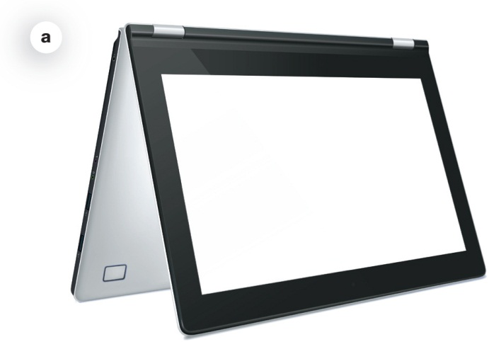
Understanding Your Computer: Types of Computers
Portable
Tablet computers
Laptop or notebook computers
Netbooks
Ultrabooks
Tablet (convertible) PCs
Notes:
8
There are two basic designs of computers: portable and stationary.
A tablet computer is a portable computer integrated into a flat multitouch-sensitive screen. It uses an onscreen virtual keyboard, but you can connect a separate keyboard via Bluetooth or wires.
A laptop or notebook computer is a portable computer that has a keyboard, monitor, and other devices integrated into a single compact case.
A netbook is a small, lightweight laptop computer that is generally 7 – 10 inches wide and has a longer battery life than a laptop.
An ultrabook is a full-featured but lightweight laptop computer designed to compete with the MacBook Air.
A tablet (or convertible) PC is similar to a laptop, but the monitor swivels and folds flat.

Slide 11
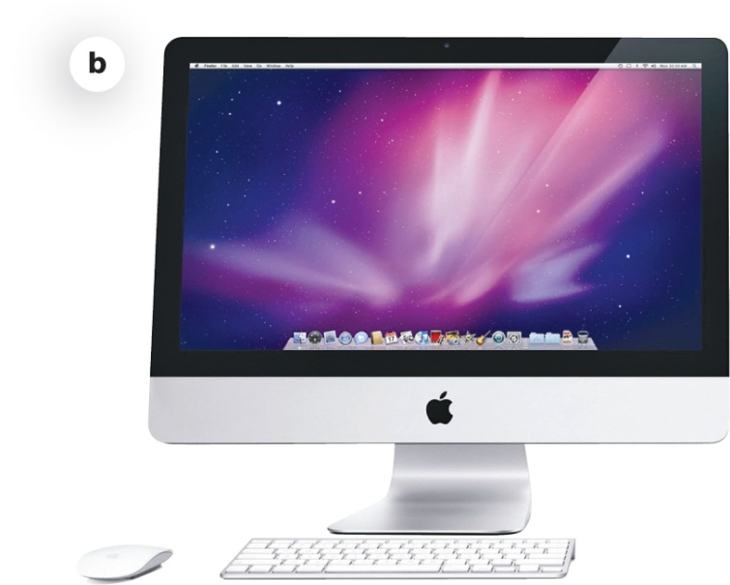
Understanding Your Computer: Types of Computers (cont.)
Stationary
Desktop computers
All-in-one computers
Notes:
8
A desktop computer is intended for use at a single location, so it is stationary. Most desktop computers consist of a separate case or tower (called the system unit) that houses the main components of the computer plus peripheral devices. A peripheral device is a component, such as a monitor or keyboard, that is connected to the computer.
An all-in-one computer, such as the Apple iMac or HP TouchSmart, eliminates the need for a separate tower because these computers house the computer’s processor and memory in the monitor. Many all-in-one models also incorporate touch-screen technology.

Slide 12
Understanding Your Computer: Types of Computers (cont.)
Mainframe
Many users simultaneously
Supercomputer
Complex calculations
Notes:
8
A mainframe is a large, expensive computer that supports many users simultaneously. Mainframes are often used in businesses that manage large amounts of data where many people are working at the same time on similar operations. Mainframes excel at executing many different computer programs at the same time.
A supercomputer is a specially designed computer that performs complex calculations rapidly. Supercomputers are used when complex models requiring intensive mathematical calculations are needed. Supercomputers are designed to execute a few programs as quickly as possible.

Slide 13
Understanding Your Computer: Types of Computers (cont.)
Embedded
Self-contained
Example: electronic thermostat
Smartphone
Notes:
8
An embedded computer is a specially designed computer chip that resides in another device, such as your car or the electronic thermostat in your home. Embedded computers are self-contained computer devices that have their own programming that typically don’t receive input from you or interact with other systems.
A smartphone does more than let you make and answer phone calls. It also has productivity (application software), media player, and camera features, as well as Web connectivity. A smartphone has a CPU, memory, and storage just like a laptop computer.

Slide 14
Input Devices
Enter data and instructions
Input devices
Keyboards
Mouse
Microphone
Scanner
Digital camera
Stylus
Notes:
12
An input device enables you to enter data (text, images, and sounds) and instructions (user responses and commands) into your computer.
A keyboard is an input device you use to enter typed data and commands, and a mouse is used to enter user responses and commands.
There are other input devices as well. Microphones input sounds and scanners and digital cameras input nondigital text and digital images, respectively.
A stylus is an input device that looks like a skinny pen, which you use to tap commands or draw on a screen.

Slide 15
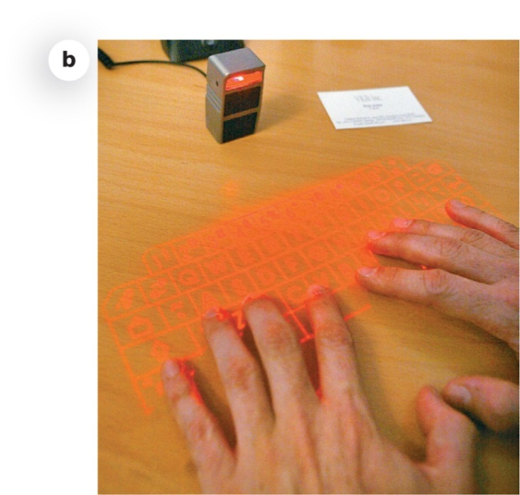
Input Devices: Keyboards
Touch screen keyboards
QWERTY layout
Wireless keyboards
Bluetooth technology
Alternative keyboards
Notes:
13
Touch screens display screens that respond to commands initiated by touching them with your finger or a stylus.
The most common keyboard layout is a QWERTY keyboard. It gets its name from the first six letters in the top-left row of alphabetic keys on the keyboard.
Wireless keyboards send data using radio frequency (RF) wireless technology.
Bluetooth technology is a wireless transmission standard that connects devices to peripheral devices.
Virtual laser keyboards project an image of a keyboard and sensors detect the motion of your fingers as you “type.”

Slide 16
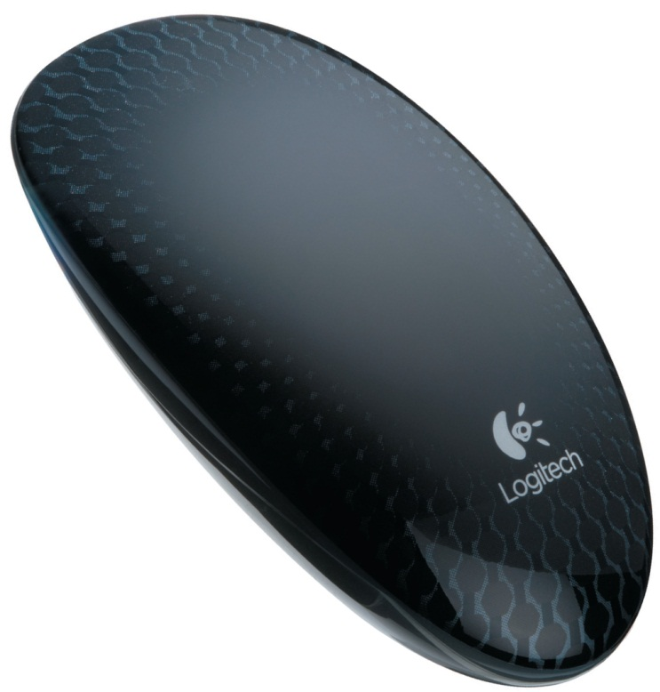
Input Devices: Mice and Other Pointing Devices
Optical mouse
Wireless mouse
Touch pad or trackpad
Notes:
An optical mouse uses an internal sensor or laser to detect the mouse’s movement. The sensor sends signals to the computer, telling it where to move the pointer on the screen.
Wireless mice connect either through Bluetooth or a USB receiver.
The Microsoft Touch Mouse is a multi-touch wireless mouse that allows you to perform a variety of touch-screen tasks.
Most laptops have a touch pad (or trackpad)—a small, touch-sensitive area at the base of the keyboard. Mac laptops include multitouch trackpads.

Slide 17
Input Devices: Mice and Other Pointing Devices (cont.)
Game controllers
Joysticks
Game pads
Steering wheels
Most are wireless
Notes:
17
Game controllers such as joysticks, game pads, and steering wheels are also considered input devices because they send data to the computer. They have buttons and miniature pointing devices that provide input to the computer.
Most game controllers, such as those for Rock Band and the Wii system, are wireless to provide extra mobility.

Slide 18
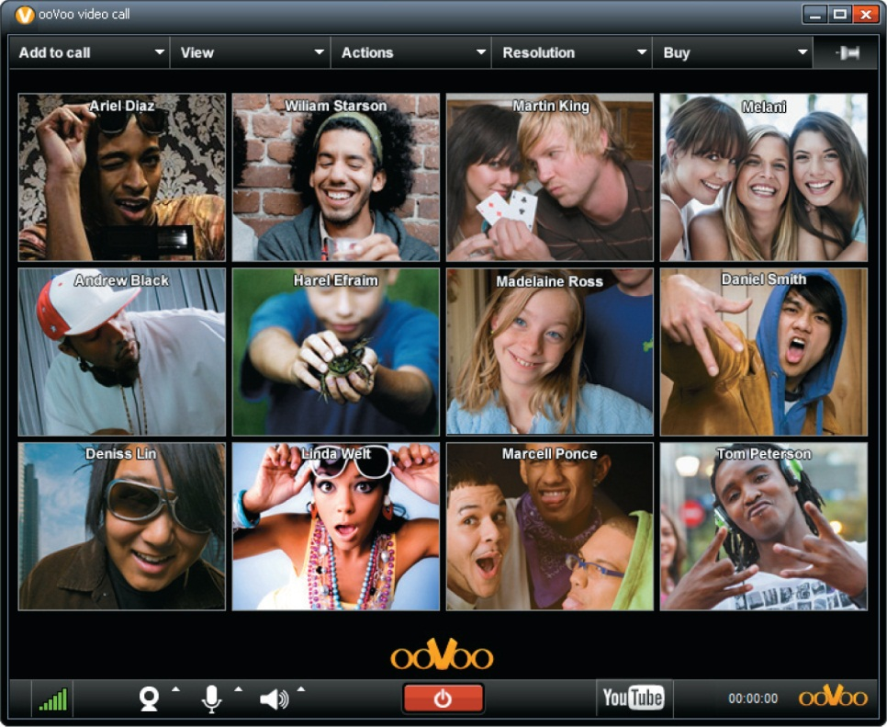
Input Devices: Image Input
Digital cameras, camcorders, cell phones
Scanners
Webcams
Notes:
Digital cameras, camcorders, and cell phones are common devices for capturing pictures and video, and all of them are considered input devices.
Scanners can also input images. They create a digital image, which you can print, scan, or e-mail.
A webcam is a small camera that sits on top of a computer monitor (connected to the computer by a cable) or is built into a laptop or tablet computer. Webcams are able to capture still images but they’re used mostly for capturing and transmitting live video.

Slide 19
Input Devices: Sound Input
Microphone (mic)
Types of microphones
Close talk
Omnidirectional
Unidirectional
Clip-on (lavalier)
Notes:
17
Inputting sound to your computer requires using a microphone (mic), a device that lets you capture sound waves (such as your voice) and transfer them to digital format on your computer. Most laptop and tablet computers come with built-in microphones.
Built-in microphones don’t always provide the best performance. You may want to consider adding other types of microphones such as close talk, omnidirectional, unidirectional, or clip-on (lavalier) for the best results.

Slide 20
Output Devices
Send data out of the computer
Text
Pictures
Sounds
Video
Monitors
Printers
Speakers and earphones
Notes:
23
An output device lets you send processed data out of your computer in the form of text, pictures (graphics), sounds (audio), or video.
The most common output device is a monitor (sometimes referred to as a display screen), which displays text, graphics, and video as soft copies (copies you can see only on screen).
Another common output device is a printer, which creates hard copies (copies you can touch) of text and graphics.
Speakers and earphones (or earbuds) are the output devices for sound.

Slide 21
Output Devices: Monitors
Liquid crystal display (LCD)
Light-emitting diode (LED)
Notes:
23
The most common type of monitor is a liquid crystal display (LCD), also called a flat-panel monitor, which is light and energy-efficient.
Some newer monitors use light-emitting diode (LED) technology, which is even more energy efficient, and might have better color accuracy and thinner panels than LCD monitors.
CRT monitors are considered legacy technology, or computing devices that use techniques, parts, and methods that are no longer popular.

Slide 22
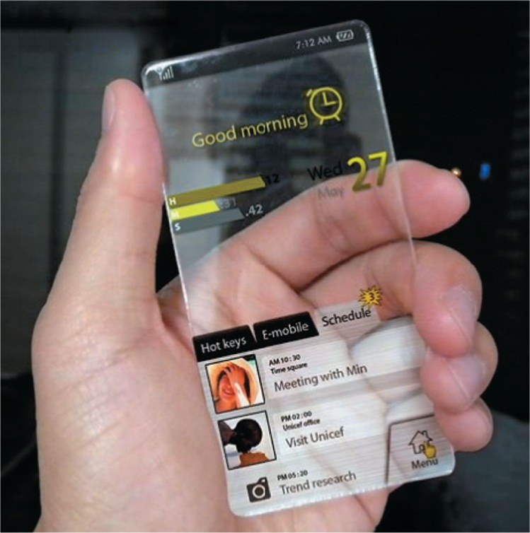
Output Devices: Monitors (cont.)
Organic light-emitting diode (OLED)
Notes:
23
Organic light-emitting diode (OLED) displays use organic compounds that produce light when exposed to an electric current. Unlike LCDs and LEDs, OLEDs do not require a backlight to function and therefore draw less power and have a much thinner display, sometimes as thin as 3 mm. They are also brighter and more environmentally friendly than LCDs. Because of their lower power needs, OLED displays run longer on a single battery charge than do LEDs, which is why OLED technology is probably the technology used in your cell phone, iPod, and digital camera.

Slide 23
Output Devices: Monitors (cont.)
How LCD monitors work
Made up of pixels
Two or more sheets of material
Liquid crystal solution
Crystals block or let light through
Notes:
25
Monitor screens are grids made up of millions of tiny dots called pixels.
LCD monitors are made of two or more sheets of material filled with a liquid crystal solution. A fluorescent panel at the back of the LCD monitor generates light waves. When electric current passes through the liquid crystal solution, the crystals move around and either block the fluorescent light or let the light shine through. This blocking or passing of light by the crystals causes images to form on the screen.

Slide 24
Output Devices: Monitors (cont.)
Quality of an LCD
Aspect ratio
Resolution
Contrast ratio
Viewing angle
Brightness
Response time
Notes:
26
The aspect ratio is the width-to-height proportion of a monitor.
The screen resolution is the clearness or sharpness of the image.
The contrast ratio is the measure in the difference in light intensity between the brightest white and the darkest black.
The viewing angle measures how far you can move to the side of the monitor before the image quality degrades to unacceptable levels.
Brightness is a measure of the greatest amount of light showing when the monitor is displaying pure white.
Response time is the time it takes for a pixel to change color.

Slide 25
Output Devices: Monitors (cont.)
27-inch monitor
2560 × 1440 pixels
21.5-inch monitor
1680 × 1050 pixels
Blu-ray movies
Require at least 1920 × 1080 pixels
Notes:
28
The bigger the monitor, the more you can display, and depending on what you want to display, size might matter. In general, the larger the panel, the larger number of pixels it can display.
For example, a 27-inch monitor can display 2560 × 1440 pixels, whereas a 21.5-inch monitor might only be able to display 1680 × 1050 pixels.
However, most new monitors have at least a 1920 × 1080 resolution, which is required to display Blu-ray movies.

Slide 26
Output Devices: Monitors (cont.)
Built-in features
Speakers
Webcams
Microphones
Multiformat memory card reader
USB port
Notes:
28
Some monitors, especially those on laptop computers, come with built-in features such as speakers, webcams, and microphones.
A built-in multiformat memory card reader is convenient for displaying images directly on the monitor or for downloading quickly from a camera memory card to your PC.
Another nice feature to look for in a desktop LCD monitor is a built-in USB port. This feature lets you connect extra peripherals easily without reaching around the back of the PC.

Slide 27
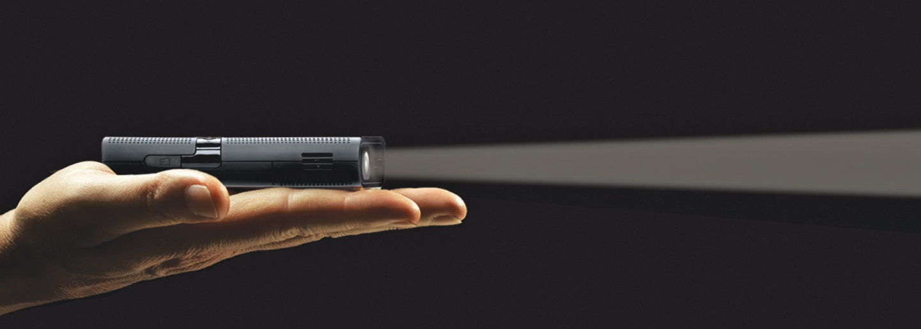
Output Devices: Monitors (cont.)
Projector
Entertainment projectors
Notes:
28
A projector lets you project images from a computing device onto a wall or viewing screen. Projectors are used in business and education settings.
Many projectors are small and lightweight, and some, such as the 3M Mpro, are small enough to fit in the palm of your hand.
Entertainment projectors, such as the Discovery Expedition, include stereo speaks and an array of multimedia connectors, making them a good option for use in the home to display TV programs, DVDs, digital images, or video games in a large format.

Slide 28
Output Devices: Printers
Inkjet printers
Laser printers
Nonimpact printers have replaced impact printers almost entirely
Notes:
29
There are two primary categories of printers: inkjet and laser, both of which are considered nonimpact printers. A nonimpact printer sprays ink or uses laser beams to transfer marks onto the paper.
An impact printer has tiny hammer-like keys that strike the paper through an inked ribbon, making marks on the paper. For most users, impact printers are legacy technology.

Slide 29
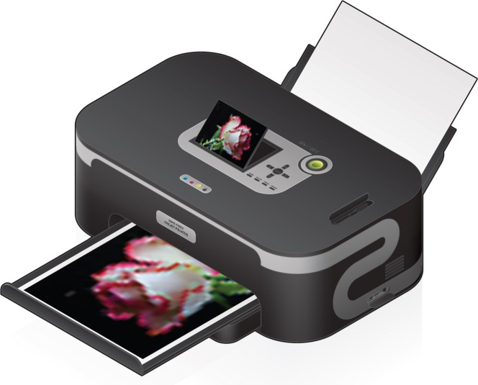
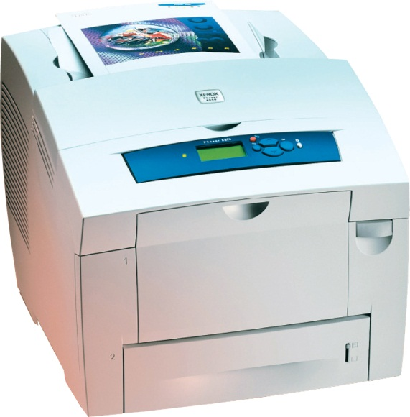
Output Devices: Printers (cont.)
Inkjet
Affordable
High-quality color
Quick and quiet
Laser
Faster printing speed
Higher quality printouts
More expensive
Notes:
30
Inkjet printers are popular because they are affordable and produce high-quality color printouts quickly and quietly. Inkjet printers work by spraying tiny drops of ink onto paper and are great for printing black-and-white text as well as color images.
Laser printers use laser beams and static electricity to deliver toner (similar to ink) onto the correct areas of the page. Heat is used to fuse the toner to the page, making the image permanent. They have a faster printing speed than inkjet printers and produce higher quality printouts.

Slide 30
Output Devices: Printers (cont.)
Wireless printer
No wires
Print to same printer from different places
Two types
WiFi
Bluetooth
Print from portable devices
Notes:
Wireless printers let several people print to the same printer from different devices and any location in the home.
There are two types of wireless printers: WiFi and Bluetooth. Both WiFi and Bluetooth printers have a range of up to approximately 300 feet. WiFi sends data more quickly than Bluetooth.
Wireless printers are also great for printing from portable devices. If you’re using a device running Apple’s iOS (such as an iPhone), AirPrint makes printing easy. AirPrint is a feature of iOS that facilitates printing to AirPrint-compatible wireless printers.

Slide 31
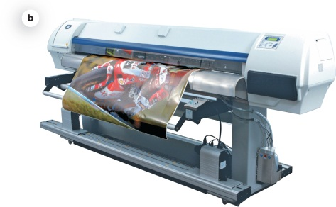
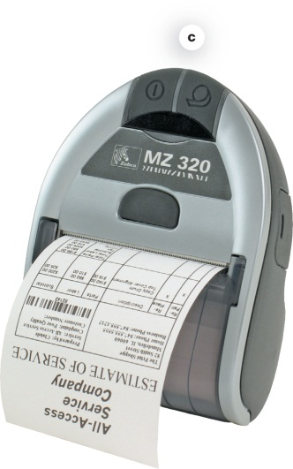
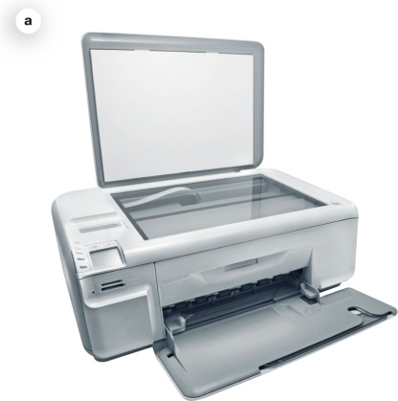
Output Devices: Printers (cont.)
All-in-one printer
Printer, scanner, copier, and fax
Plotter
Prints oversize images
Thermal printer
Notes:
All-in-one printers combine the functions of a printer, scanner, copier, and fax into one machine.
Plotters print oversize pictures that require the drawing of precise and continuous lines. Plotters use a computer-controlled pen that provides a great level of precision.
Thermal printers work by either by melting wax-based ink onto ordinary paper (a process called thermal wax transfer printing) or burning dots onto specially coated paper (a process called direct thermal printing).

Slide 32
Output Devices: Printers (cont.)
Selecting a printer
Primary printing need first
Speed (pages per minute)
Resolution (dots per inch)
Color output
Cost of consumables
Notes:
31
First, you need to decide your primary printing need—color photos and graphics or black-and-white, text-based documents.
Speed: Print speed is measured in pages per minute (PPM).
Resolution: Resolution refers to a printer’s image clarity. Resolution is measured in dots per inch (dpi).
Color output: Printers with separate cartridges for each color produce the best quality output.
Cost of consumables: Consumables are printer cartridges and paper.

Slide 33
Sound Output
Speaker
Output device for sound
Surround-sound speakers
Wireless speaker systems
Headphones or earbuds
Notes:
Most computers include speakers, which are the output devices for sound.
A surround-sound speaker is a system of speakers and audio processing that envelops the listener in a 360-degree field of sound.
Wireless speaker systems are available to help avoid cluttering up your rooms with speaker wires.
Headphones or earbuds plug into the speaker jack on the computer to which speakers connect.

Slide 34
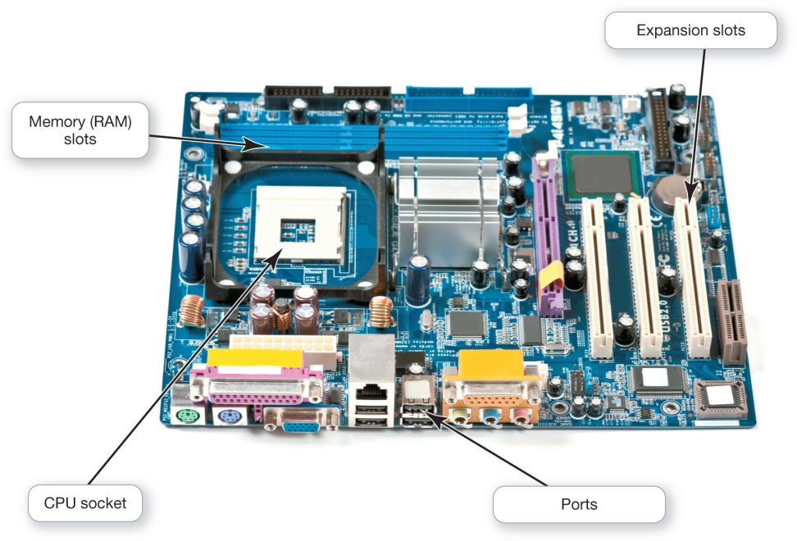
Processing and Memory on the Motherboard
Motherboard
CPU
ROM, RAM, and cache
Notes:
42
The motherboard is the main circuit board that contains the central electronic components of the computer, including the computer’s processor (CPU), its memory, and the many circuit boards that help the computer function.
On a desktop, the motherboard is located inside the system unit. In a laptop computer, the system unit is combined with the monitor and the keyboard into a single package.

Slide 35
Processing and Memory on the Motherboard (cont.)
Slots for expansion cards
Network interface card (NIC)
Notes:
42
The motherboard includes slots for expansion cards (or adapter cards), which are circuit boards that provide additional functionality.
Typical expansion cards in the system unit are sound and video cards. A sound card provides a connection for the speakers and microphone. A video card provides a connection for the monitor.
A network interface card (NIC) enables a computer to connect with other computers or to a cable modem to facilitate a high-speed Internet connection.

Slide 36
Processing and Memory on the Motherboard: Memory
RAM—Random access memory
Stores instructions and data
Series of several memory cards or modules
Temporary (volatile) storage
Notes:
Random access memory (RAM) is the place in a computer where the programs and data the computer is currently using are stored. RAM is much faster to read from and write to than the hard drive and other forms of storage.
Because the entire contents of RAM are erased when you turn off the computer, RAM is the temporary or volatile storage location.

Slide 37
Processing and Memory on the Motherboard: Memory (cont.)
ROM—Read-only memory
Stores startup instructions
Permanent (nonvolatile) storage
Notes:
Read-only memory (ROM) holds all the instructions the computer needs to start up when it is powered on. The instructions stored in ROM are permanent, making ROM a nonvolatile storage location, which means the data isn’t erased when the power is turned off.

Slide 38
Processing and Memory on the Motherboard: Processing
Central Processing Unit
CPU or processor
“Brains” of the computer
Controls all functions of the computer’s components
Processes all commands and instructions
Billions of tasks per second
Notes:
43
The central processing unit (CPU, or processor) is sometimes referred to as the “brains” of the computer because it controls all the functions performed by the computer’s other components and processes all the commands issued to it by software instructions.
Modern CPUs can perform as many as tens of billions of tasks per second without error, making them extremely powerful components.

Slide 39
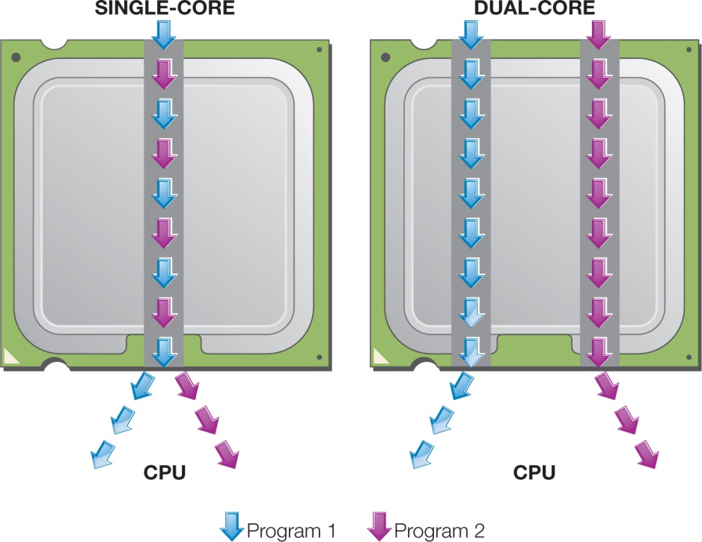
Processing and Memory on the Motherboard: Processing (cont.)
CPU Performance Measures
Processor speed measured in hertz (Hz)
Megahertz (MHz) or gigahertz (GHz)
Number of cores
Single
Dual
Quad
Eight
Notes:
43
Processor speed is measured in units of hertz (Hz). Hertz is a measurement of machine cycles per second.
Current systems run at speeds measured in gigahertz (GHz), or billions of machine cycles per second. Therefore, a 3.8 GHz processor performs work at a rate of 3.8 billion machine cycles per second.
CPU performance is also affected by the number of cores, or processing paths, the processor has. Processors have been designed that have two, four, and even eight cores.

Slide 40
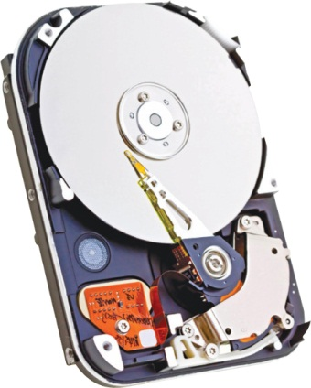
Storing Data and Information: Hard Drives
Primary device for permanent storage
Stored programs and data
Internal hard drive
Notes:
36
The hard disk drive (HDD, or hard drive) is your computer’s primary device for permanent storage of software and documents.
The hard drive is a nonvolatile storage device.
An internal hard drive resides within the system unit and usually holds all permanently stored programs and data.

Slide 41
Storing Data and Information: Hard Drives (cont.)
External hard drive
Outside the system
USB or FireWire port
Solid-State Drive (SSD)
No moving parts
No noise
Emits little heat
Requires little power
Less likely to fail
Notes:
36
External hard drives offer similar storage capacities but reside outside the system and connect via a USB or FireWire port.
The most common type of hard drive has moveable parts—spinning platters, a moving arm with a read/write head—that can fail and lead to disk failure.
The solid-state drive (SSD) has become a more feasible option for storage. SSDs have no moving parts so they’re more efficient, run with no noise, emit little heat, and require little power. They’re less likely to fail.

Slide 42
Storing Data and Information: Hard Drives (cont.)
Internal drive bays
External drive bays
House CD or DVD drives
Laptop expansion
Attach external drive
Notes:
36
Permanent storage devices are located in a computer in a space called a drive bay. There are two kinds of drive bays:
Internal drive bays cannot be seen or accessed from outside the system unit.
External drive bays can be seen and accessed from outside the system unit.
Laptop computers generally do not give you the ability to add additional drives. Expansion is done by attaching an external drive through a USB port.

Slide 43
Storing Data and Information: Cloud Storage
Types of Cloud Storage
Dropbox
OneDrive
iCloud
Google Drive
Notes:
36
Cloud storage refers to using a service that keeps your files on the Internet (in the “cloud”) rather than on a local device.
Dropbox is a web-based application for storing files in the cloud.
Any files saved in the Dropbox folder are accessible to all other devices via the Internet. Folders in Dropbox can be shared with other Dropbox users.
Other cloud storage alternatives include Microsoft OneDrive, Apple iCloud, and Google Drive.

Slide 44
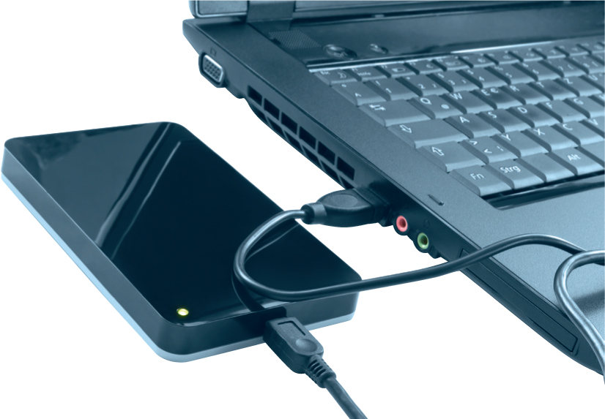
Storing Data and Information: Flash Storage
External hard drives
Large portable storage needs
Small and lightweight
USB port
Notes:
For large portable storage needs, there are portable external hard drives, which are small enough to fit into your pocket and have storage capacities of 4 TB (or larger). These devices are small and lightweight and are enclosed in a protective case.
They attach to your computer via the USB port.

Slide 45
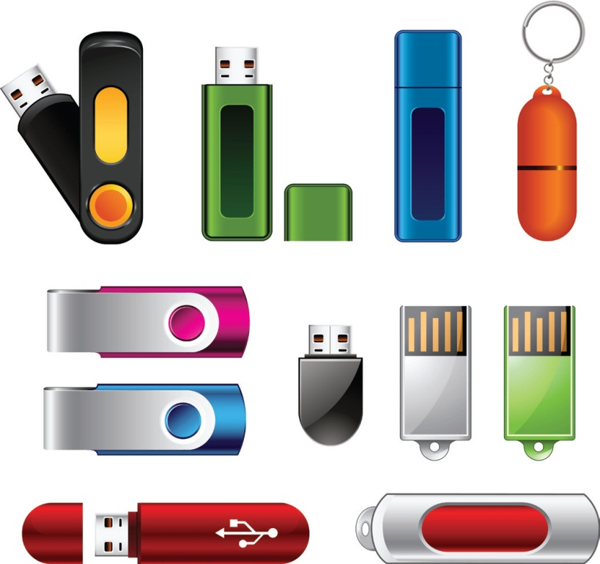
Storing Data and Information: Flash Storage (cont.)
Flash drive—jump drive, USB drive, thumb drive
Solid-state flash memory
No moving parts
Significant storage capacity
USB
Appears as another disk drive
Notes:
38
A flash drive (sometimes referred to as a jump drive, USB drive, or thumb drive) uses solid-state flash memory, storing information on an internal memory chip.
When you plug a flash drive into your computer's USB port, it appears in the operating system as another disk drive. You can write or read data from it as you would a hard drive.
Flash drives can have significant storage capacity, currently as much as 256 GB.

Slide 46
Storing Data and Information: Flash Storage (cont.)
Wireless flash drives
Notes:
38
New wireless flash drives are also appearing on the market to make transferring files from portable devices easier. They look like normal flash drives but they can connect to your portable devices via WiFi after installing the appropriate app. Up to eight devices can be connected to the flash drive at once, and the drive can even stream media to three devices simultaneously.

Slide 47
Storing Data and Information: Flash Memory (cont.)
Flash memory card
Convenient
Portable
Solid-state flash memory
Transfer data between devices
Notes:
38
A flash memory card, such as an SD card, is another convenient means of portable storage. Like the flash drive, memory cards use solid-state flash memory.
Flash memory cards let you transfer digital data between your computer and devices such as digital cameras, smartphones, video cameras, and printers.

Slide 48
Storing Data and Information: Optical Storage
Compact discs (CDs)
Audio files
Digital video discs (DVDs)
Store more data than CDs
Blu-ray discs (BDs)
Notes:
Most desktop and laptop computers include at least one optical drive that can read from and maybe even write to CDs, DVDs, or Blu-ray discs.
Compact discs (CDs) were initially created to store audio files.
Digital video (or versatile) discs (DVDs) are the same size and shape as CDs but can hold up to 14 times more data.
Blu-ray discs (BDs) can hold as much as 50 GB of data.

Slide 49
Connecting Peripherals to the Computer
Port
Attaches peripherals
Notes:
We have discussed peripheral devices that input, store, and output data and information. A port is a place through which a peripheral device attaches to the computer so that data can be exchanged between it and the operating system. Although peripherals may connect to devices wirelessly, ports are still often used for connections.

Slide 50
Connecting Peripherals to the Computer: High-Speed and Data Transfer Ports
Thunderbolt Ports
Developed by Intel
Fiber optic technology
Transfer speeds up to 10 GB/s
Notes:
Thunderbolt is the newest input/output technology on the market. It was developed by Intel using fiber optic technology and can achieve blazingly fast transfer speeds of up to 10 Gb/s. Thunderbolt ports are very useful for laptops and ultrabooks because one Thunderbolt port can allow you to connect up to six different peripherals to your computer.
Apple was the first computer maker to integrate the ports into their hardware although other manufacturers are now following suit.

Slide 51
Connecting Peripherals to the Computer: High-Speed and Data Transfer Ports
Universal serial bus (USB)
USB 3.0 standard port
Transfer speeds of 4.8 Gbps
Notes:
A universal serial bus (USB) port is the port type most commonly used to connect input and output devices to the computer. This is mainly because of the ready availability of USB-compatible peripherals.
USB ports can connect a wide variety of peripherals, including keyboards, printers, mice, smartphones, external hard drives, flash drives, and digital cameras, to computing devices.
The current USB 3.0 standard provides transfer speeds of 4.8 Gbps and charges devices faster than its predecessor.

Slide 52
Connecting Peripherals to the Computer: High-Speed and Data Transfer Ports (cont.)
FireWire 800
Doubles rate to 800 Mbps
Declining in popularity
Notes:
You might also see other ports, such as FireWire 800, especially on Apple computers.
The current standard, FireWire 800, provides a fast transfer rate of 800 Mbps.
Devices such as external hard drives and digital video cameras benefit from the speedy data transfer capabilities of FireWire.
As more peripherals are released with Thunderbolt capabilities, we should see FireWire declining in popularity.

Slide 53
Connecting Peripherals to the Computer: Connectivity and Multimedia Ports
Connectivity port
Access to networks and the Internet
Ethernet port
Modem port
Notes:
Another set of ports on your computer helps you communicate with other computers. A connectivity port can give you access to networks and the Internet. To find a connectivity port, look for a port resembling a phone jack but slightly larger. This port is called an Ethernet port. Ethernet ports transfer data at speeds up to 10,000 Mbps. You can use an Ethernet port to connect your computer to a cable modem, or a network.

Slide 54
Connecting Peripherals to the Computer: Connectivity and Multimedia Ports (cont.)
Audio ports
Connect headphones, microphones, speakers
Notes:
Other ports on the back and sides of the computer include the audio and video ports. Audio ports are where you connect headphones, microphones, and speakers to the computer.

Slide 55
Connecting Peripherals to the Computer: Connectivity and Multimedia Ports (cont.)
Video ports
Connect monitors and multimedia devices
HDMI
Notes:
A video port is needed to attach a monitor to a desktop computer or a second, larger display to a laptop computer. HDMI ports are now the most common video port on computing devices.
A high-definition multimedia interface (HDMI) port is a compact audio-video interface that allows both HD video and uncompressed digital audio to be carried on one cable.
All currently available monitors, DVD players, televisions, and game consoles have at least one HDMI port.

Slide 56
Connecting Peripherals to the Computer: Connectivity and Multimedia Ports (cont.)
Video graphics array (VGA) & digital video interface (DVI):
Older LCD monitors and other multimedia devices
Mini DisplayPort:
Older Apple computers
Notes:
The video graphics array (VGA) port and the digital video interface (DVI) port are two ports to which older LCD monitors and televisions connect.
Some Apple computers still feature a Mini DisplayPort for connection of video peripherals. Adapters are available for the Mini DisplayPort that allow the connection of older DVI and VGA devices.

Slide 57
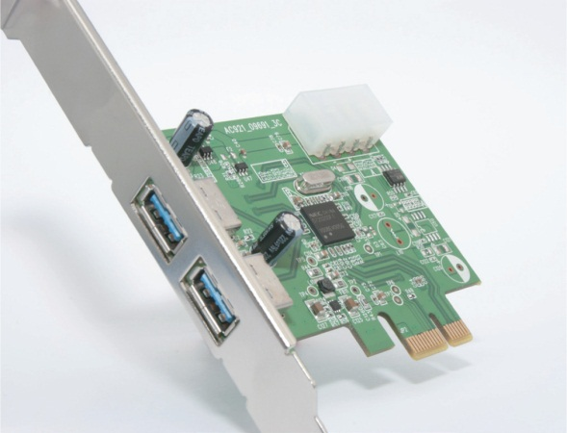
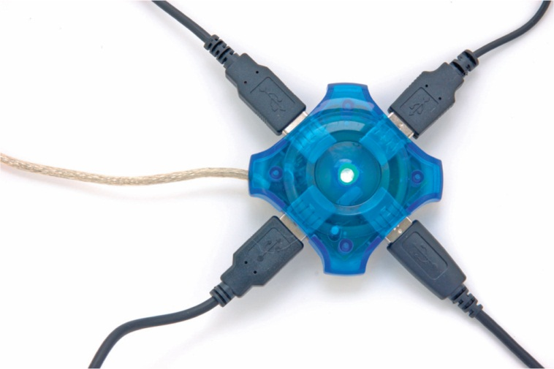
Connecting Peripherals to the Computer: Adding Ports: Expansion Cards and Hubs
Expansion cards
New port standards
Expansion hubs
Connect several devices to a port
Notes:
If you’re looking to add the newest ports to an older computer or to expand the number of ports on it, you can install special expansion cards into an open expansion slot on the motherboard to provide additional ports.
Another alternative is adding an expansion hub, a device that connects to one port, such as a USB port, to provide additional new ports. It works like the multiplug extension cords used with electrical appliances.

Slide 58
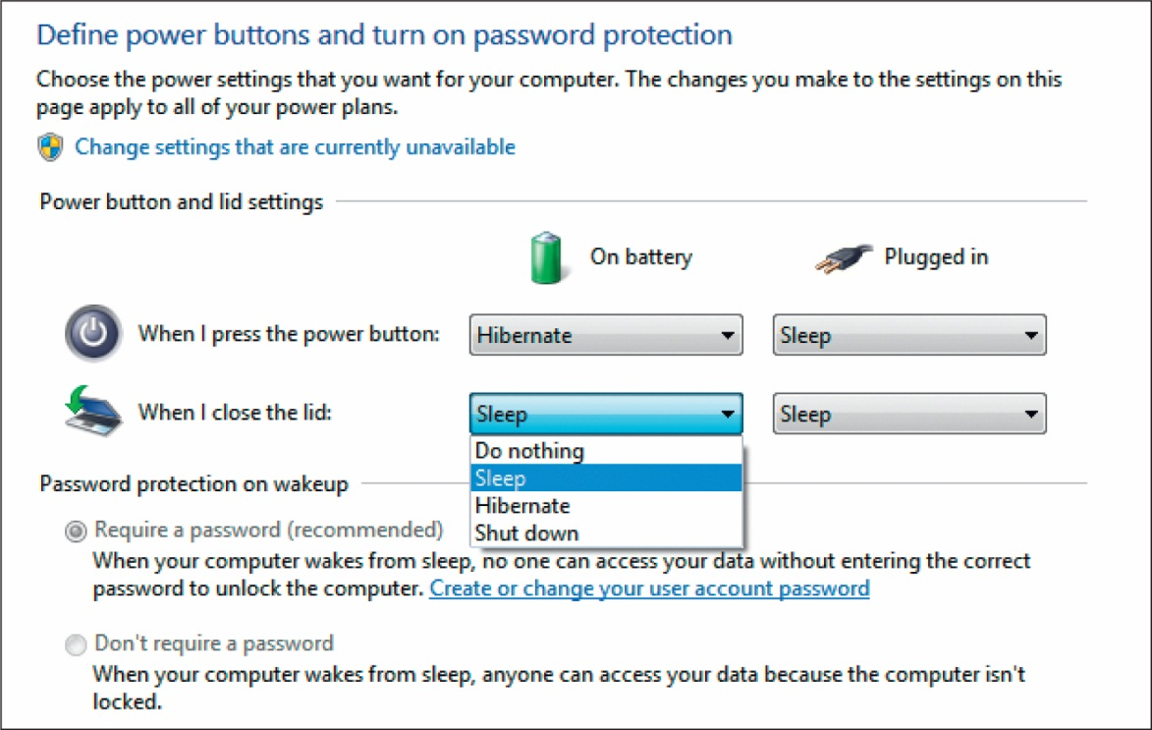
Power Controls
Power supply
Cold boot
Notes:
35
The power supply, which is housed inside the system unit, transforms the wall voltage to the voltages required by computer chips.
Powering on your computer from a completely turned-off state, such as when you start your computer in the morning, is called a cold boot.
In Windows 8, you can turn your computer off by pressing the computer’s power button or by using the Shut Down option from the power icon found under Settings on the Charms bar.

Slide 59
Power Controls
Turning off your computer
Stress on computer vs. wasting electricity
Power-management settings
Windows 8 power-management options
Notes:
35
Some people say you should always leave your computer on because turning it off and on causes stress on the computer.
Others say you should shut down because it is not environmentally friendly and wastes electricity.
Modern operating systems include power-management settings that allow power-hungry components to shut down after a short idle period.
With the power-management options of Windows 8, computers only need to be shut down to be repaired, moved or to install hardware.

Slide 60
Power Controls (cont.)
Sleep Mode
Windows 8 power management
Documents, applications, data remain in RAM
Hibernate
Similar to Sleep
Data stored on hard drive
Computer is powered off
Warm boot
Notes:
In Windows 8, the main method of power management is Sleep. When your computer enters Sleep Mode, all of documents, applications, and data remain in RAM (memory).
The Hibernate option is similar to Sleep except data is stored on the hard drive and the computer is powered off. This uses much less battery power than Sleep.
Restarting the system while it’s on is called a warm boot.

Slide 61
Setting It All Up
Ergonomics
Guidelines to follow
Monitor position
Adjustable chair
Proper position while typing
Take breaks
Adequate lighting
Notes:
46
Ergonomics refers to how you set up your computer to minimize risk of injury or discomfort.
The following guidelines can help keep you comfortable and productive:
Position your monitor correctly.
Purchase an adjustable chair. Make sure your feet touch the floor.
Assume a proper position while typing. Your wrists should be flat with respect to the keyboard, and your forearms should be parallel to the floor.
Take breaks.
Ensure that the lighting is adequate.

Slide 62
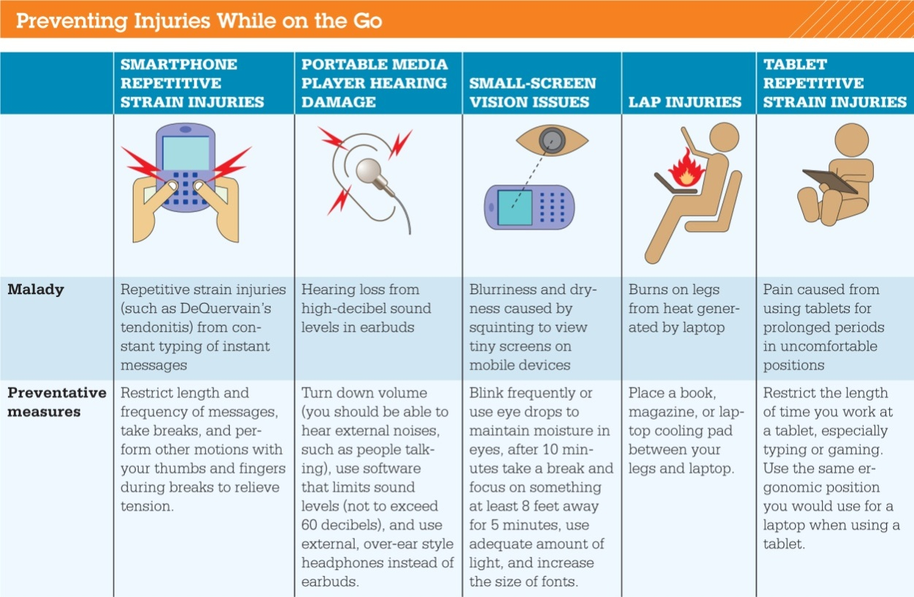
Setting It All Up (cont.)
Mobile computing and injury prevention
Notes:
46
Working with mobile computing devices presents interesting challenges when it comes to injury prevention.
The figure above provides guidelines on preventing injuries when computing on the go.

Slide 63
Setting It All Up (cont.)
Devices for People with Disabilities
Voice recognition
Keyboards with larger keys
Display screen keyboards
Specialized input consoles
Keyboards designed for one hand
Special trackballs
Head-mounted pointing devices
Notes:
46
Devices available for people with disabilities include:
Voice recognition
Keyboards with larger keys
Keyboards that display on a touch screen or specialized input consoles
Keyboards designed for individuals who can only use one hand
Special trackballs that can be manipulated with one finger
Head-mounted pointing devices.

Slide 64
Chapter 2 Summary Questions
What exactly is a computer, and what are its four main functions?
Notes:
47
Computers are devices that process data. They help organize, sort, and categorize data to turn it into information. The computer’s four major functions are as follows:
Input: Gather data, or allow users to enter data.
Process: Manipulate, calculate, or organize that data.
Output: Display data and information in a form suitable for the user.
Storage: Save data and information for later use.

Slide 65
Chapter 2 Summary Questions
What is the difference between data and information?
Notes:
48
Data is a representation of a fact or idea. The number 3 and the words televisions and Sony are pieces of data. Information is data that has been organized or presented in a meaningful fashion. An inventory list that indicates that “three Sony televisions” are in stock is processed information. It allows a retail clerk to answer a customer query about the availability of merchandise. Information is more powerful than raw data.

Slide 66
Chapter 2 Summary Questions
What are bits and bytes, and how are they measured?
Notes:
49
The language computers use to process data is called binary language, consists of two numbers: 0 and 1. Each 0 and each 1 is a binary digit, or bit. Eight bits create one byte. In computers, each letter of the alphabet, each number, and each special character consists of a unique combination of eight bits (one byte)—a string of eight 0s and 1s. For describing large amounts of storage capacity, the terms megabyte, gigabyte, terabyte, and petabyte are used.

Slide 67
Chapter 2 Summary Questions
What devices can I use to get data into the computer?
Notes:
50
An input device enables you to enter data and instructions. You use keyboards to enter typed data and commands, whereas you use the mouse to enter user responses and commands. Touch screens are display screens that respond to commands initiated by a touch with a finger or a stylus. Images are input into the computer with scanners, digital cameras, camcorders, and smartphones. Live video is captured with webcams and digital video recorders. Microphones capture sounds. There are many different types of microphones, including desktop, headset, and clip-on models.

Slide 68
Chapter 2 Summary Questions
What devices can I use to get information out of the computer?
Notes:
51
Output devices enable you to send processed data out of your computer. It can take the form of text, pictures, sounds, or video. Monitors display soft copies of text, graphics, and video, whereas printers create hard copies of text and graphics. There are two primary categories of printers: inkjet and laser. Specialty printers are also available. These include all-in-one printers, plotters, and thermal printers. When choosing a printer, you should think about factors such as speed, resolution, color output, and cost. Speakers are the output devices for sound.

Slide 69
Chapter 2 Summary Questions
What’s on the motherboard?
Notes:
52
The motherboard contains the CPU, which coordinates the functions of all other devices on the computer. CPU performance is affected by the speed of the processor, the amount of cache memory, and the number of processing cores. RAM is also located on the motherboard. RAM is where all the data and instructions are held while the computer is running. ROM is responsible for housing instructions to help start up a computer. The motherboard also houses slots for expansion cards, which have specific functions that augment the computer’s basic functions. Typical expansion cards are sound and video cards.

Slide 70
Chapter 2 Summary Questions
Where are information and programs stored?
Notes:
53
To save programs and information permanently, you need to save them to the hard drive, another permanent storage device, or to the cloud. The hard drive is your computer’s primary device for permanent storage. Mechanical hard drives have spinning platters, whereas solid-state drives use solid-state memory. External hard drives are essentially internal hard drives that have been made portable by enclosing them in a protective case. Cloud storage refers to nonvolatile storage locations that are maintained on the Internet. Optical drives are another means of permanent, portable storage. Flash drives are another portable means of storing data.

Slide 71
Chapter 2 Summary Questions
How are devices connected to the computer?
Notes:
54
There is a wide variety of ports that allow you to hook up peripheral devices. The fastest type of port is the Thunderbolt port. The most common type of port used is the USB port. FireWire ports provide additional options for data transfer. Connectivity ports, such as Ethernet ports, give you access to networks and the Internet. HDMI ports are the most common multimedia port. They are used to connect monitors, TVs, and gaming consoles to computing devices and handle both audio and video data. Audio ports are where you connect headphones, microphones, and speakers to computing devices.

Slide 72
Chapter 2 Summary Questions
What’s the best way to turn my computer on and off and when should it be done?
Notes:
54
Power your computer on from a completely turned-off state. In Windows 8, you can turn your computer off by pressing the computer’s power button or by using the Shut Down option from the power icon found under Settings on the Charms bar. With the power-management options of Windows 8 you only need to shut down your computer completely when you need to repair or install hardware in the system unit or move it to another location. If you use your computer for only a little while each day, it would be best to power it off completely after each use.

Slide 73
Chapter 2 Summary Questions
How do I set up my computer to avoid strain and injury?
Notes:
55
Ergonomics refers to how you arrange your computer and equipment to minimize your risk of injury or discomfort. Ergonomics includes positioning your monitor correctly, buying an adjustable chair, assuming a proper position while typing, making sure the lighting is adequate, and not looking at the screen for long periods. Other good practices include taking frequent breaks and using specially designed equipment such as ergonomic keyboards. Ergonomics is also important to consider when using mobile devices.

Slide 74
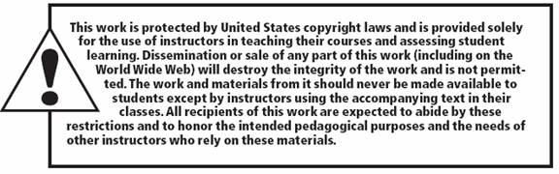
All rights reserved. No part of this publication may be reproduced, stored in a retrieval system, or transmitted, in any form or by any means, electronic, mechanical, photocopying, recording, or otherwise, without the prior written permission of the publisher. Printed in the United States of America.
Copyright © 2015 Pearson Education, Inc.

